Slide 1
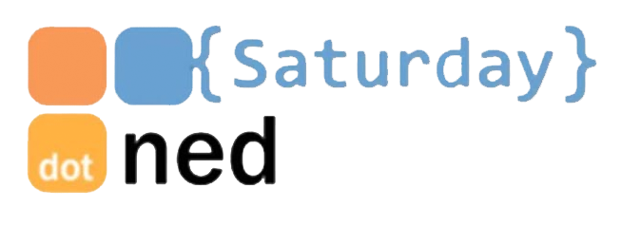
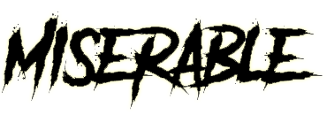


or ?
The 5 Durable Functions patterns explained!
Kees Schollaart
Technical Evangelist
Microsoft.

Slide 2
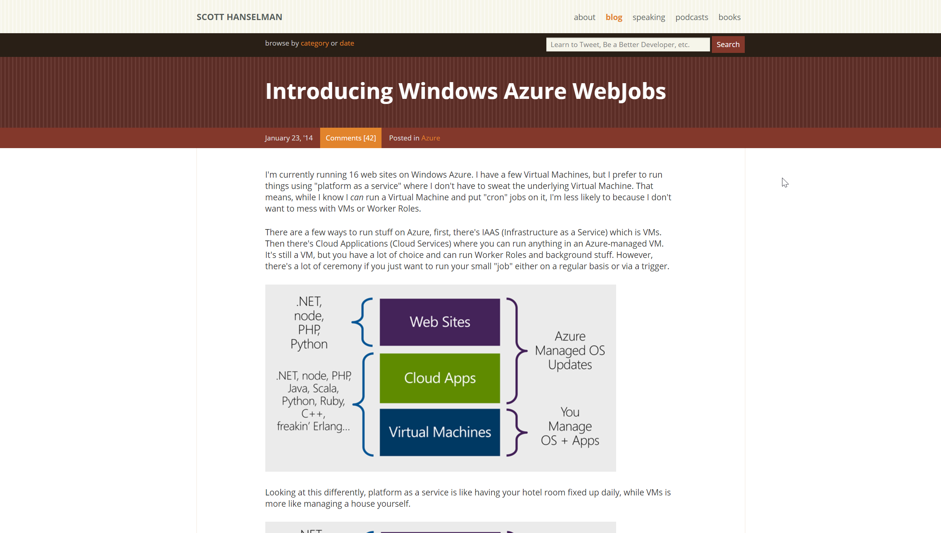
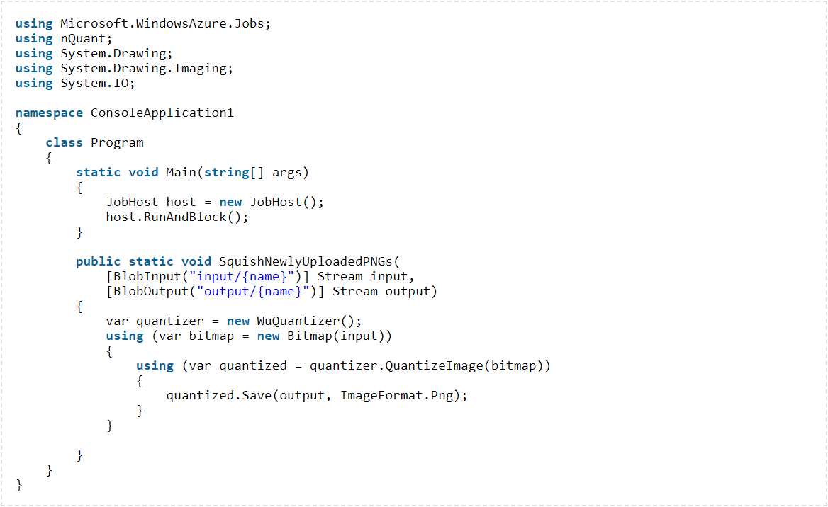
2014 > 2016 > 2017 > 2018
Notes:
The story…
Webjobs
Triggered / continuous
Attributes / bindings
Scalable
Coming from IIS/MSMQ/Services > Azure / Cloud Services

Slide 3
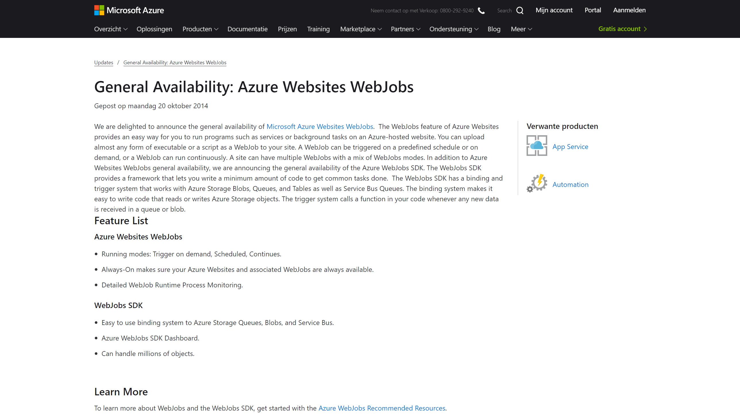
2014 > 2016 > 2017 > 2018

Slide 4
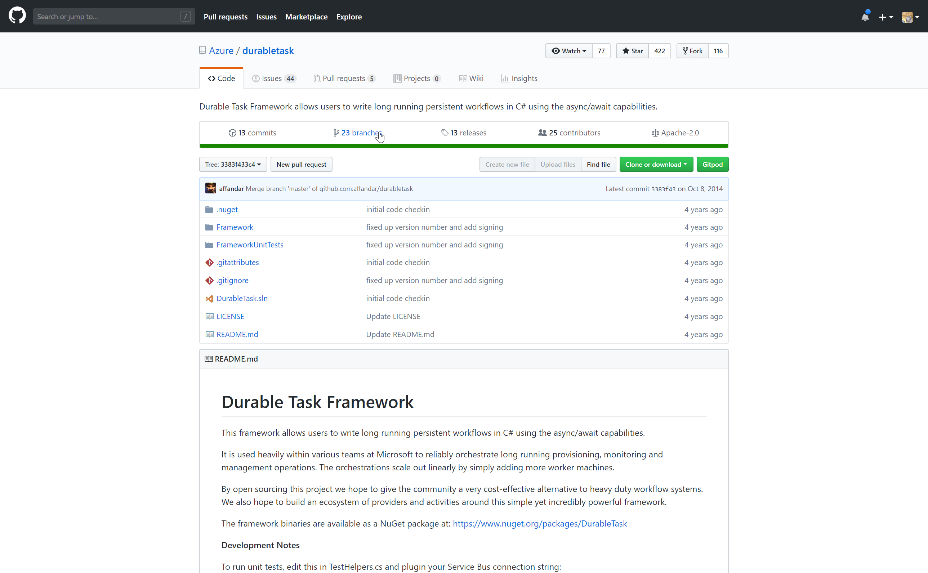
2014 > 2016 > 2017 > 2018

Slide 5
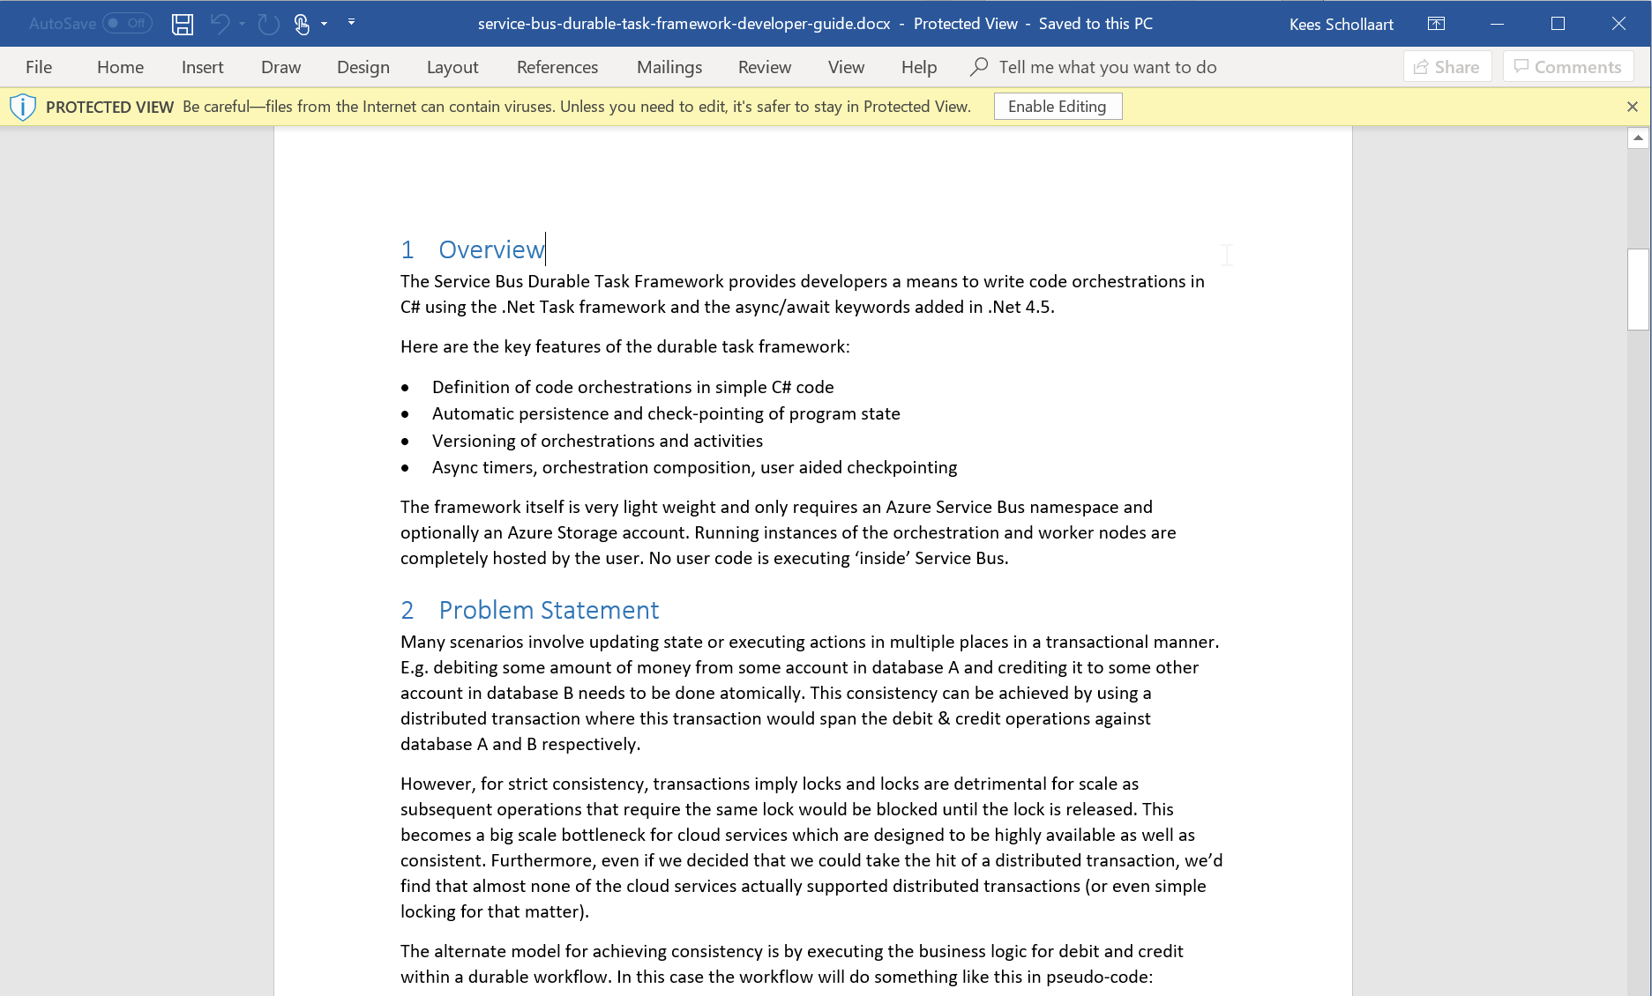
2014 > 2016 > 2017 > 2018
Notes:
Simple orch. in code
State checkpointing

Slide 6
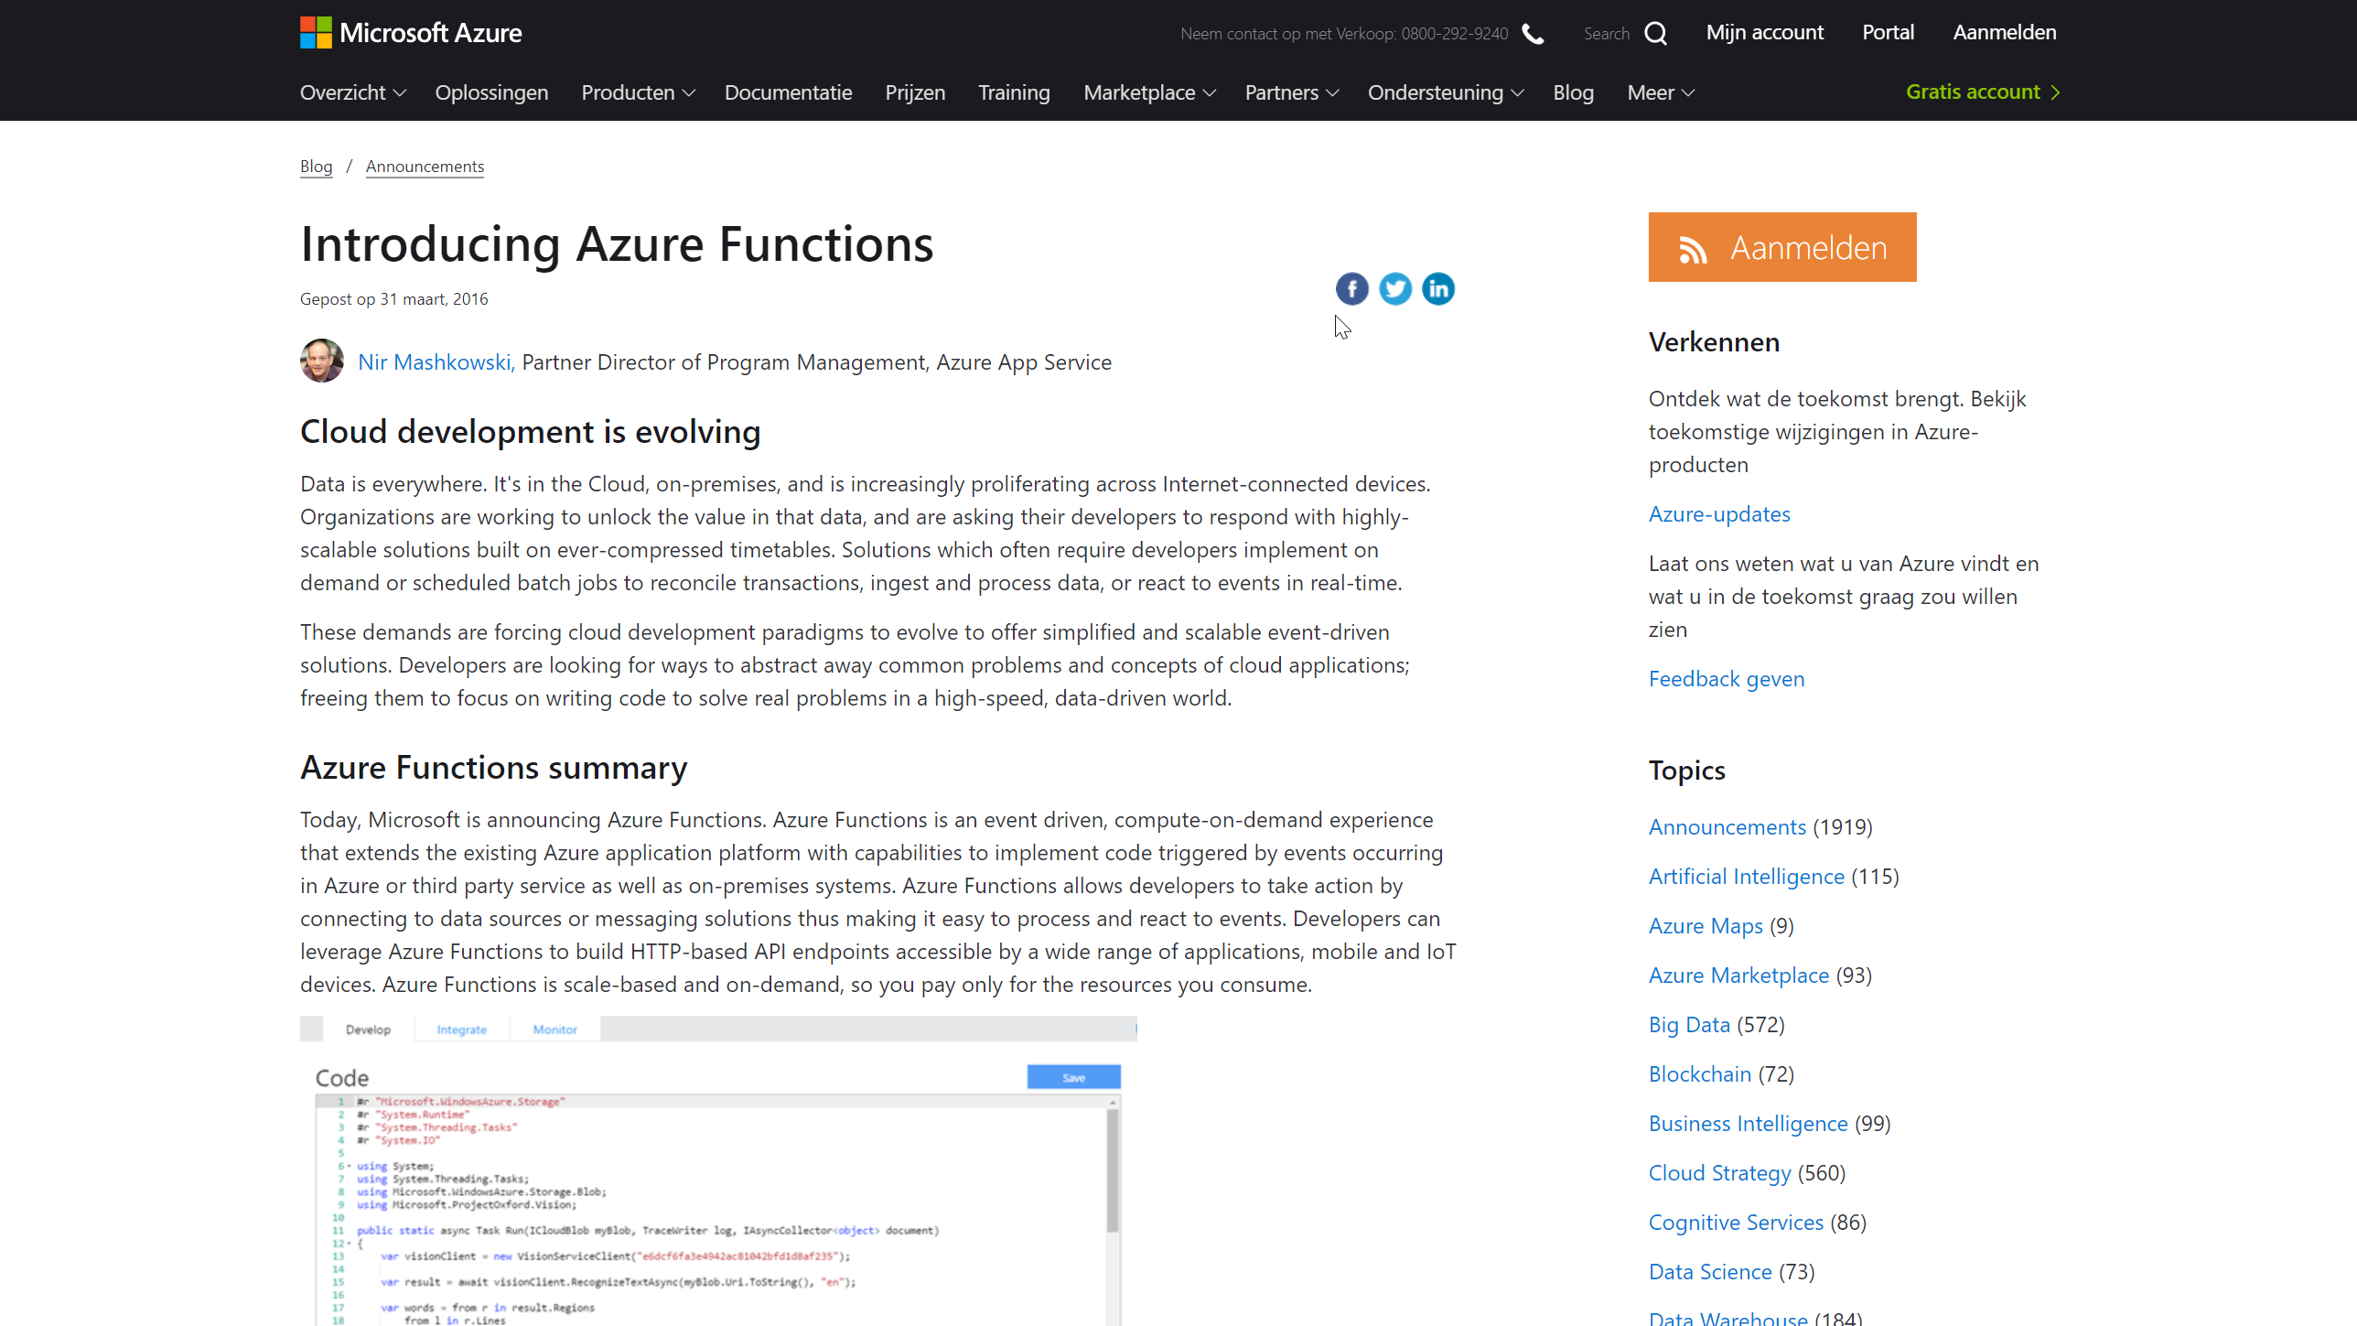
2014 > 2016 > 2017 > 2018
Notes:
Event Driven
On-demand compute
Consumption model

Slide 7
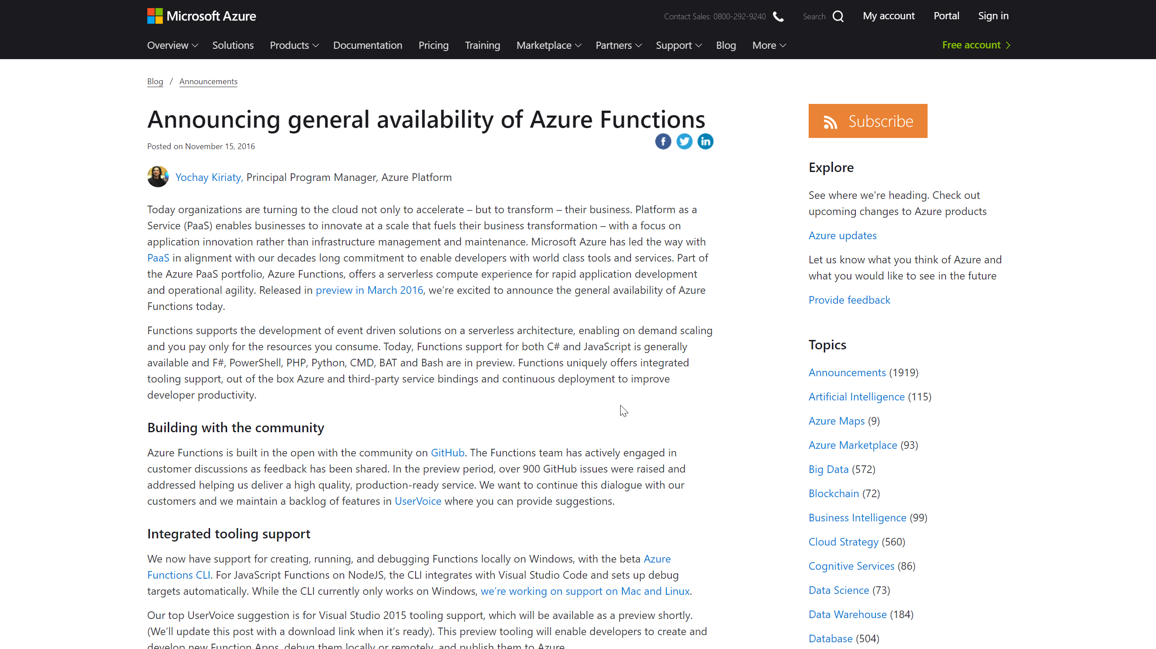
2014 > 2016 > 2017 > 2018
Notes:
Open Source
Multi language

Slide 8
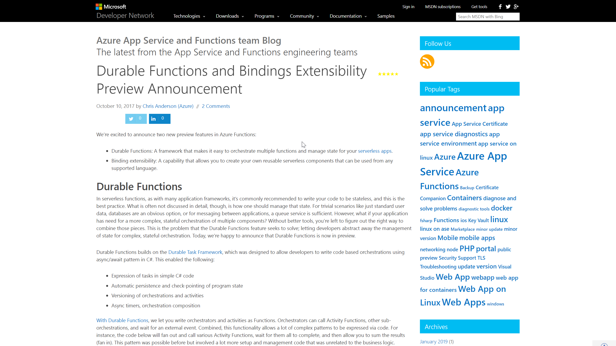
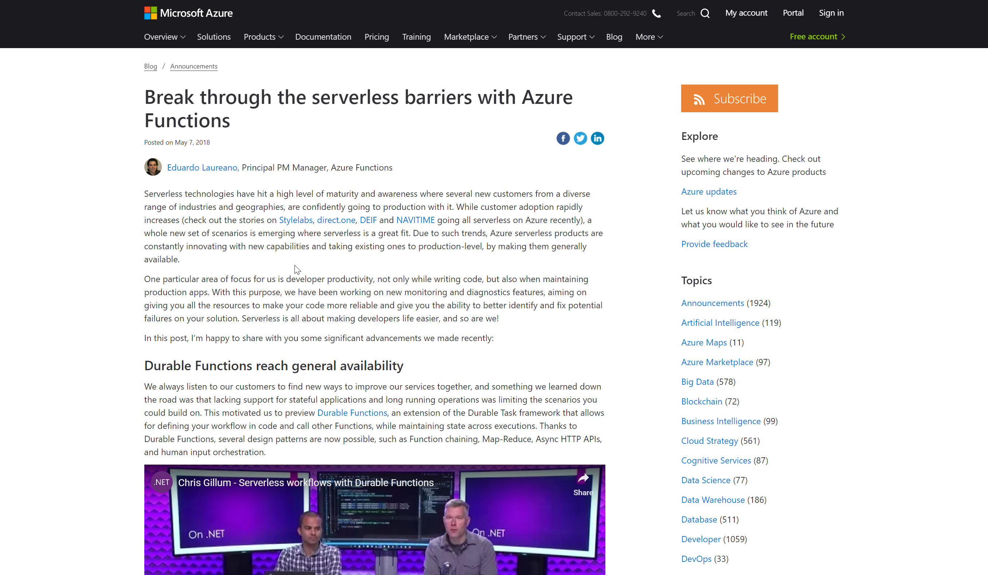
2014 > 2016 > 2017 > 2018
Notes:
Functions Binding extensibility
GA May 7

Slide 9
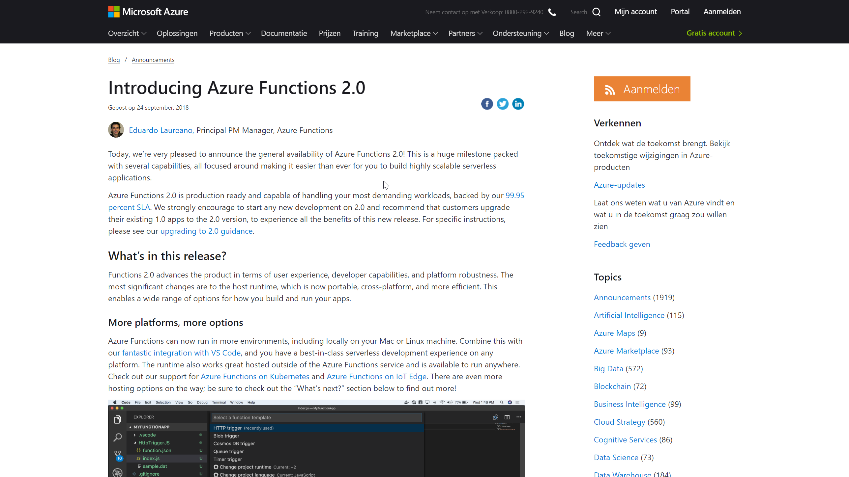
2014 > 2016 > 2017 > 2018

Slide 10
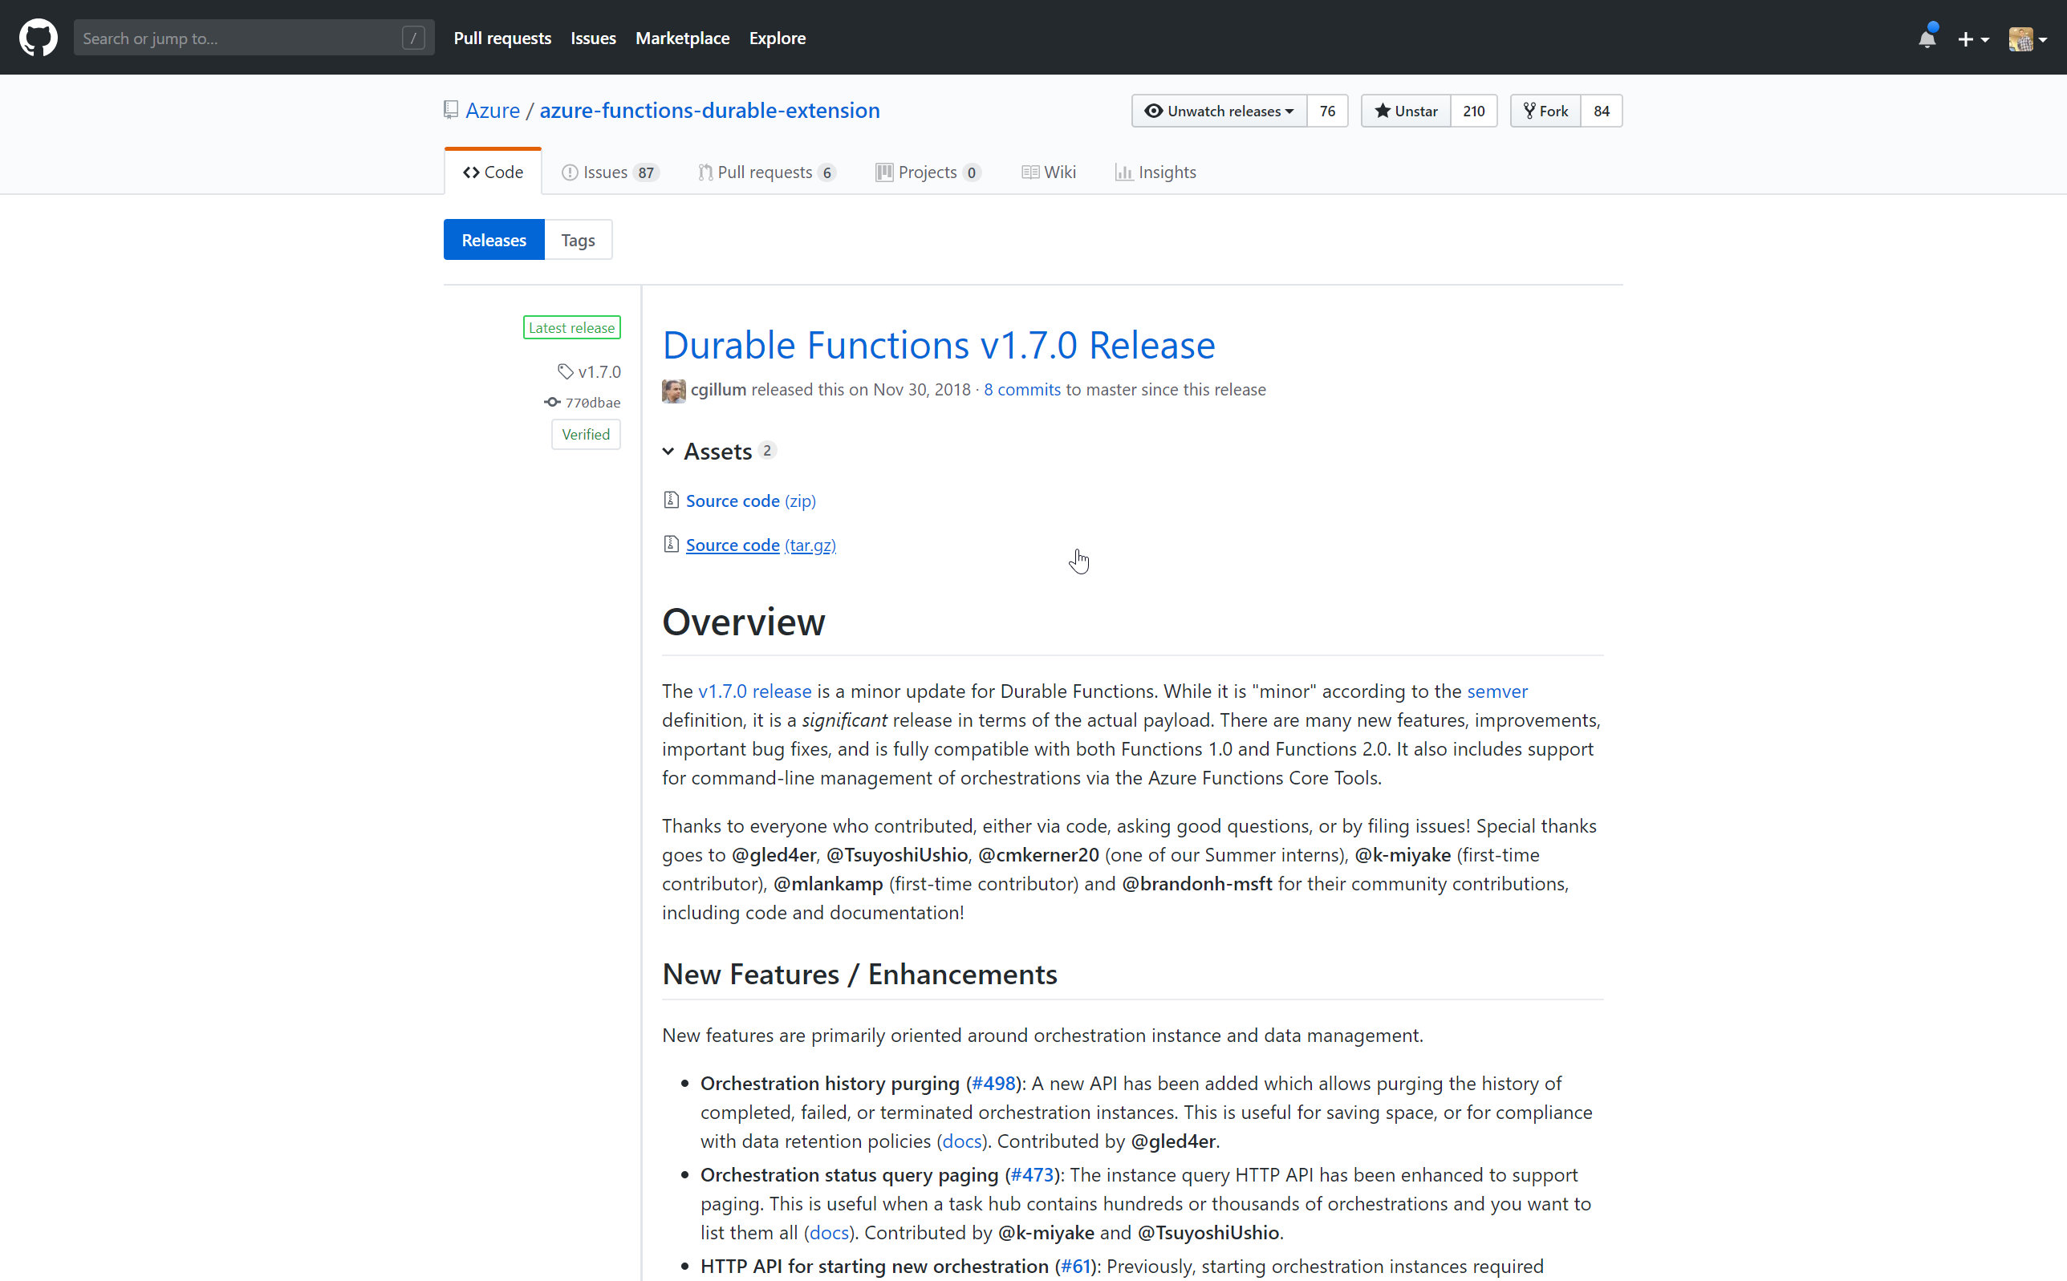
2014 > 2016 > 2017 > 2018

Slide 11


Slide 12
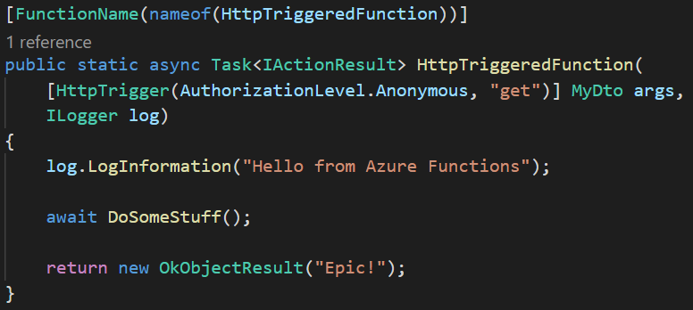
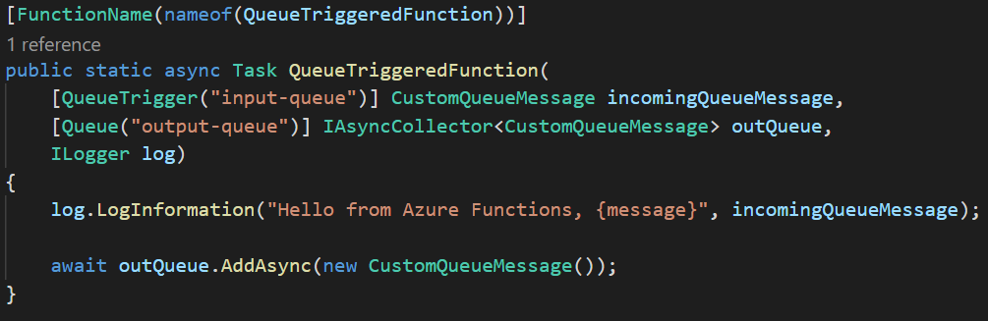
TheLooksOfAFunction()
Notes:
Opiniated model:
- Event Driven
- Short Lived
- Stateless
Problems:
- Sequencing
- Error handling
- Parallel stuff

Slide 13
Activities & Orchestrators
Activities
Do the hard work
Behave like normal functions
Orchestrator
Needs a client
Replays
Deterministic (Datime, Guid, loops, etc.)
Durable (managed state)
Notes:
Activities
Orchestrators
Needs a client /trigger / queue / http
Replays
Deterministic: datetime, guid, while(true)
Durable

Slide 14
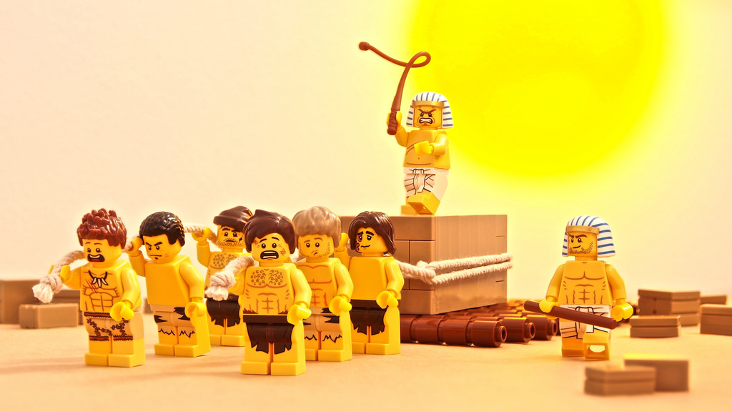

[OrchestrationTrigger]
[ActivityTrigger]
[ActivityTrigger]
[ActivityTrigger]
[ActivityTrigger]
[ActivityTrigger]

Slide 15
Example use case
New Employee
Create In database
Send welcome mail
Start Orchestrator
Get quote for leasecar
Get approval for quote
Get approval for quote

Slide 16
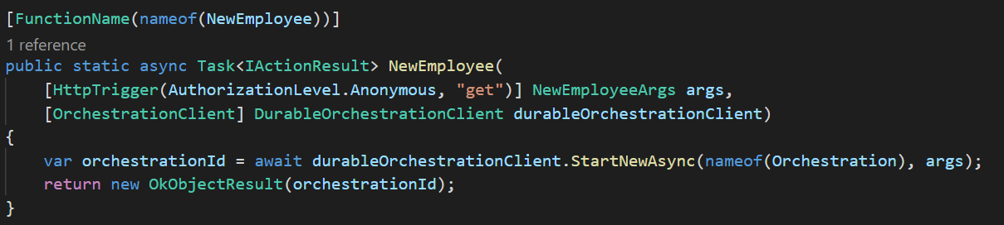
Durable: The core
Activity
Trigger
Result
Input
“Result”
Azure Functions
Start Orchestrator
await DoActivity()
“Result”
Completed
Function
Orchestrator

Slide 17
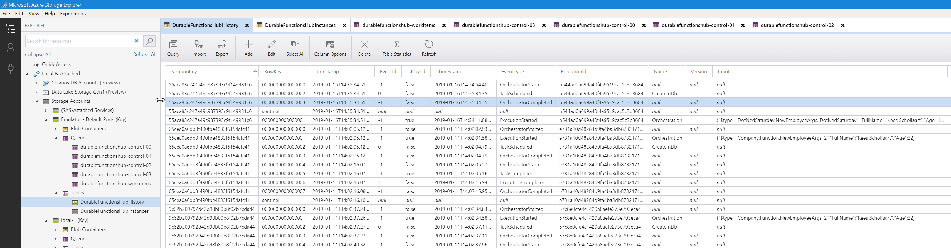
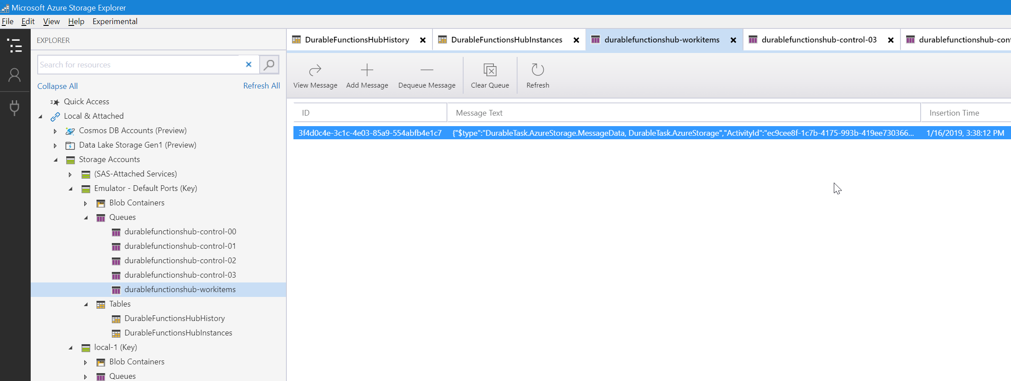

Slide 18
The 5 patterns
Chaining
Fan-out/fan-in
Async HTTP APIs
Monitoring
Human interaction

Slide 19
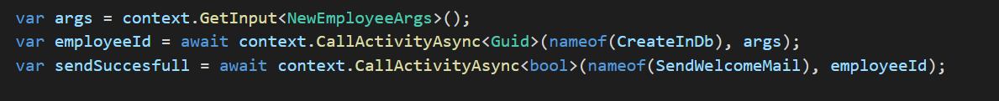
Durable: Chaining
CreateInDb()
SendWelcomeMail()
{ “name”: “John”, “age”: 12 }
HTTP
200 OK
“{employeeId}”
“{employeeId}”
“SendSuccesfull”
Azure Functions
await CreateInDb ()
“{employeeId}”
Start Orchestrator
{ “name”: “John”, “age”: 12 }
await SendWelcomeMail ()
“SendSuccesfull”
Completed
Function
Orchestrator

Slide 20
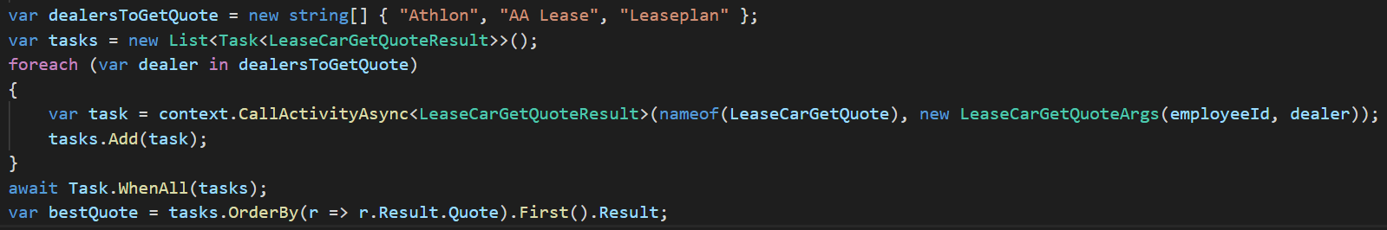
Durable: Fan-out/Fan-in
LeaseCarGetQuote()
{ “employeeId”: “1”, “dealer”: “Leaseplan” }
LeaseCarGetQuote()
HTTP
200 OK
{ “employeeId”: “1”, “dealer”: “Athlon” }
{quote1}
{quote2}
Azure Functions
await Task.WhenAll(tasks)
[ {quote1}, {quote2} ]
Start Orchestrator
Completed
Function
Orchestrator
Notes:
Order > Orderline
Aggregations

Slide 21
Durable: Async API’s
{ "runtimeStatus":“Completed", "lastUpdatedTime":"2017-03-16T21:20:47Z",
"customStatus": { "nextActions": ["A", "B", "C"], "foo": 2 }, ...
}
{ "runtimeStatus":"Running", "lastUpdatedTime":"2017-03-16T21:20:47Z", ...
}
HTTP
200 OK
HTTP: GetStatus
HTTP: GetStatus
Azure Functions
Start Orchestrator
Completed
Function
Orchestrator
await DoStuff()
Function
Notes:
Order > Orderline(s)

Slide 22
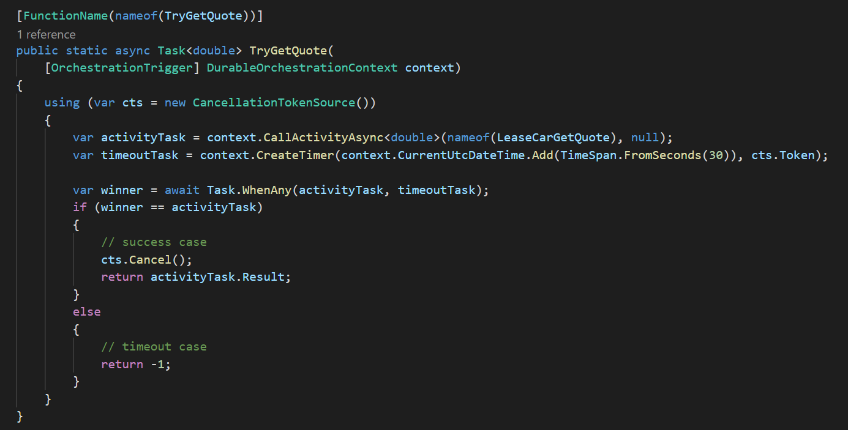
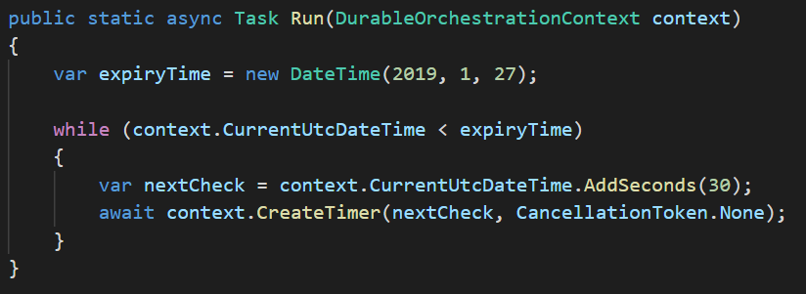
Durable: Monitoring
HTTP
200 OK
Azure Functions
Start Orchestrator
await context.CreateTimer (whenToReturn)
Function
Orchestrator
while(true)
Notes:
High score
Scheduled/buffered mail
Complexer schedules
Timeout

Slide 23
Durable: Human Intervention
HTTP
200 OK
200 OK
HTTP: RaiseEvent
{ args }
Azure Functions
Start Orchestrator
await WaitForExternalEvent (eventName)
{ args }
Completed
Function
Orchestrator

Slide 24
Demo

Slide 25
Other stuff
SubOrchestrators (stages, parallel, reuse)
Deployment
Versioning
Monitoring
Portable

Slide 26
Azure Durable Functions make managing state and (complex) workflows easy

